Slide 1
Course Summary
I. Introduction
II. Single component systems
III. Solutions
IV. Phase diagrams
V. Phase stability
VI. Surfaces
VII. Heat of formation
VIII. Heat capacity
IX. Solution models and equations of state
X. Thermodynamics and materials modeling
XI. Experimental methods

Slide 2
Course Summary
I. Introduction:
Define Terms;
Basic Definitions;
Gibbs Thompson;
Hess’ Law (not path dependent);
Second law and reversibility;
Equilibrium;
Third law T = 0 K Boltzmann equation;
Legendre transform;
Maxwell equations;
Gibbs-Duhem equation (Gibbs phase rule)

Slide 3
What happens to the energy when I heat a material?
Or How much heat, dq, is required to change the temperature dT? (Heat Capacity, C)
dq = C dT
C = dq/dT
-S U V
H A
-P G T
Constant Volume, C_{V}
dU = dq + dw
With only pV work (expansion/contraction), dw_{ec} = -pdV
dU = dq – pdV
For constant volume
(dU)_{V} = dq, so
C_{V} = (dU/dT)_{V}, or the energy change with T: (dU)_{V} = C_{V} dT
Constant Volume
Computer Simulation
Helmholtz Free Energy, A
A = U – TS = G - pV
Constant Pressure, C_{p}
dU = dq + dw = dq – pdV (only e/c work, i.e. no shaft work)
Invent Entropy H = U + PV so dH = dU + pdV + Vdp
(dH)_{p} = dU + pdV for constant pressure
With only pV work (expansion/contraction), dw_{ec} = -pdV
dq = dU + pdV = (dH)_{p}
C_{p} = (dH/dT)_{p} , or the enthalpy change with T: (dH)_{p} = C_{p} dT
Constant Pressure
Atmospheric Experiments
Gibbs Free Energy, G
G = H – TS = A + pV

Slide 4
Size dependent enthalpy of melting
(Gibbs-Thompson Equation)
-S U V
H A
-P G T
For bulk materials, r = ∞, at the melting point ΔG = ΔH – T∞ΔS = 0
So, T∞ = ΔH/ΔS Larger bonding enthalpy leads to higher T∞ , Greater randomness gain on melting leads to lower T∞.
For nanoparticles there is also a surface term,
(ΔG) V = (ΔH – T_{r}ΔS)V + σA = 0, where T_{r} is the melting point for size r nanoparticle
If V = r³ and A = r² and using ΔS = ΔH/T∞ this becomes,
r = σ/(ΔH(1– T_{r}/T∞)) or T_{r} = T∞ (1 - σ/(rΔH)
Smaller particles have a lower melting point, and the dependence suggests a plot of T_{r}/T∞ against 1/r

Slide 5
Derive the expression for C_{p} – C_{V}
-S U V
H A
-p G T
C_{p} - C_{v} = α²VT/κ_{T}
α = (1/V) (dV/dT)_{p}
κ_{T} = (1/V) (dV/dP)_{T}
C_{V} = (dU/dT)_{V}
From the Thermodynamic Square
dU = TdS – pdV so C_{V} = (dU/dT)_{V} = T (dS/dT)_{V} - p (dV/dT)_{V}
Second term is 0 dV at constant V is 0
(dS/dT)_{V} = C_{V} /T
Similarly
C_{p} = (dH/dT)_{p}
From the Thermodynamic Square
dH = TdS + Vdp so C_{p} = (dH/dT)_{p} = T (dS/dT)_{p} - V (dp/dT)_{p}
Second term is 0 dp at constant p is 0
(dS/dT)_{p} = C_{p} /T
Write a differential expression for dS as a function of T and V
dS = (dS/dT)_{V}dT + (dS/dV)_{T}dV using expression for C_{V} above and Maxwell for (dS/dV)_{T}
dS = C_{V} /T dT + (dp/dT)_{V}dV use chain rule: (dp/dT)_{V} = -(dV/dT)_{p} (dP/dV)_{T} = Vα / (Vκ_{T})
Take the derivative for C_{p}: C_{p}/T = (dS/dT)_{p} = C_{V} /T (dT/dT)_{p} + (α/κ_{T})(dV/dT)_{p} = C_{V} /T + (Vα²/κ_{T})
C_{p} - C_{v} = α²VT/κ_{T}

Slide 6
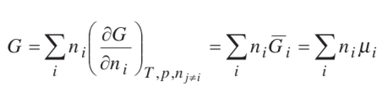






Gibbs-Duhem Equation
Consider a binary system A + B makes a solution
Intensive properties are not independent, T, p, µ
For I components, only I – 1 have independent properties (Gibbs phase rule) if T and p are variable.
Determine partial molar quantities at equilibrium from number of moles
Partial vapor pressure from total vapor pressure
-S U V
H A
-p G T
Fundamental equation with chemical potential:
At constant T and p:
So, at constant T and p:
Reintroducing the T and p dependences:

Slide 7
Clausius-Clapeyron Equation
Consider two phases at equilibrium, α and β
-S U V
H A
-p G T
dμ_{α} = dμ_{β}
dG = Vdp –SdT
so
V^{α}dp – S^{α}dT = V^{β}dp – S^{β}dT
so
dp_{trans}/dT = ΔS/ΔV
and
ΔG = 0 = ΔH – T_{trans}ΔS so ΔS = ΔH/T_{trans}
and
dp_{trans}/dT = ΔH/(T_{trans}ΔV) Clapeyron Equation
For transition to a gas phase, ΔV ~ V^{gas}
and for low density gas (ideal) V = RT/p
d(lnp_{vap})/dT = ΔH_{vap}/(RT_{vap}²) Clausius-Clapeyron Equation
This allows calculation of the vapor pressure as a function of T

Slide 8
Course Summary
II. Single Component Systems:
First order transition;
Clausius-Clapeyron equation (vapor pressure calculation);
Second order transition;
Virial equation of state for phase diagram;
Phase diagram P vs T (Gibbs phase rule)
Fugacity;
Van der Waals equation (Cubic equation of state);
CALPHAD and PREOS programs

Slide 9

Clausius-Clapeyron Equation
d(ln p^{Sat})/dT = ΔH_{vap}/(RT_{vap}²) Clausius-Clapeyron Equation
d(ln p^{Sat}) = (-ΔH_{vap}/R) d(1/T) So, plot ln p^{Sat} vs 1/T
ln[p^{Sat}/ p_{C}^{Sat}] = (-ΔH_{vap}/R) [1/T – 1/T_{C}] Use the critical point as the reference state
Shortcut Vapor Pressure Calculation:

Slide 10
Like the Van’t Hoff Equation for Reaction Equilibria so escape of an ideal gas from liquid state is like a chemical reaction equilibria
Consider a chemical reaction with equilibrium constant K_{eq}
-S U V
H A
-p G T
dμ_{α} = dμ_{β}
ΔG = ΔH – TΔS
ΔG = -RTlnK_{eq}
So lnK_{eq} = -ΔH/RT + ΔS/R
Take derivative relative to T
d(ln K_{eq}) = ΔH/RT² dT Van’t Hoff Equation
Can determine ΔH from the mole fraction of reactants and products
So, plot ln K_{eq} vs 1/T

Slide 11
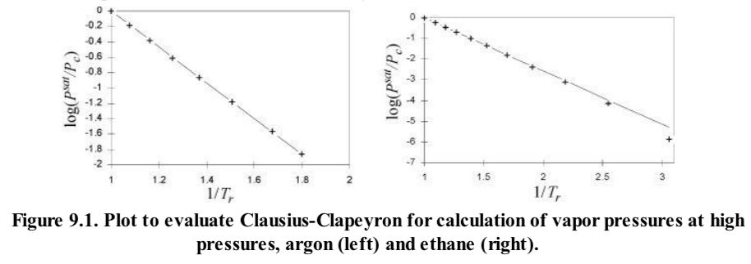
Clausius Clapeyron Equation
d(ln p^{Sat}) = (-ΔH_{vap}/R) d(1/T)
ln[p^{Sat}/ p_{R}^{Sat}] = (-ΔH_{vap}/R) [1/T – 1/T_{R}]
This is similar to the Arrhenius Plot

Slide 12
α = (1/V) (dV/dT)_{p}
κ_{T} = (1/V) (dV/dP)_{T}
What About a Second Order Transition?
For Example: Glass Transition T_{g} versus P?
There is only one “phase” present. A flowing phase and a “locked-in” phase for T_{g}.
There is no discontinuity in H, S, V
dV = 0 = (dV/dT)_{p} dT + (dV/dp)_{T} dp = VαdT – Vκ_{T}dp
dp/dT_{g} = Δα/Δκ_{T}
T_{g} should be linear in pressure.

Slide 13
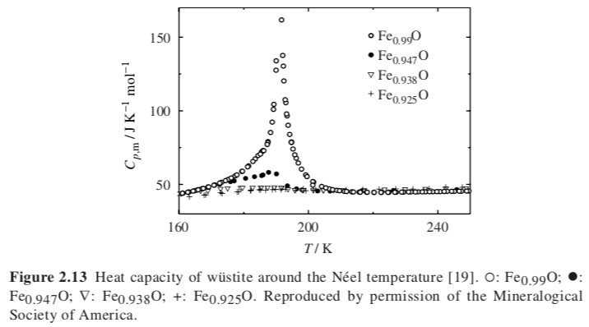
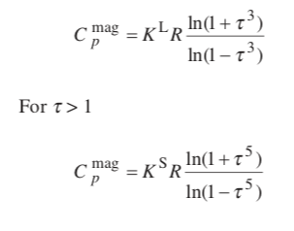
Second order transition Neel Temperature (like Curie Temp for antiferromagnetic)
Inden Model τ = T/T_{tr}
For τ <1

Slide 14
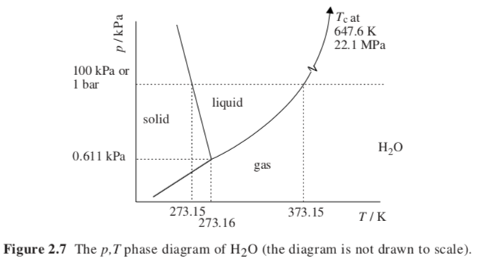
Single Component Phase Diagrams
Isochoric phase diagram
For a single component, an equation of state relates the variables of the system, PVT

Slide 15
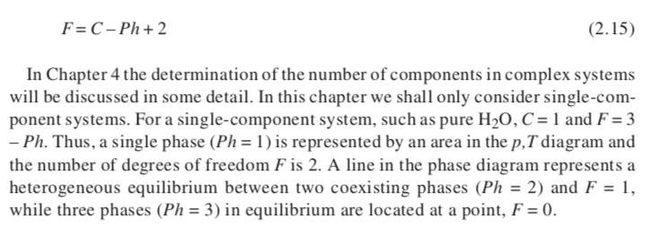
Gibbs Phase Rule

Slide 16









Z = 1
P= RT/V
Ideal Gas Equation of State
Van der Waals Equation of State
Cubic Equation of State
P = RTρ/(1-bρ) – a ρ²
Law of corresponding states
Virial Equation of State
Peng-Robinson Equation of State (PREOS)
Cubic Equation of State
Solve cubic equations (3 roots)

Slide 17
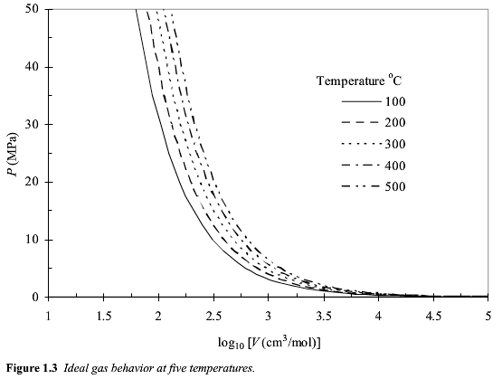
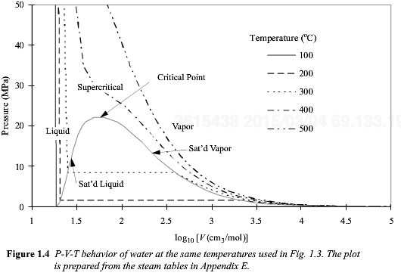
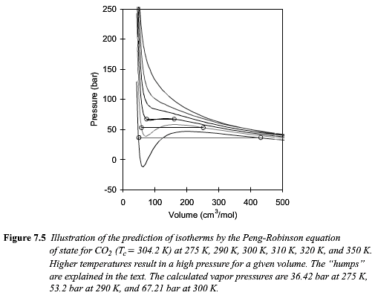

Slide 18
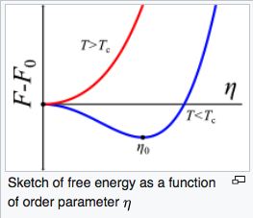
Landau theory for 2’nd order transitions
The order parameter Γ could be concentration (normal phase separation), magnetization (magnets) , orientation (LCs)
The point is to find a value for Γ above and below the critical point T_{c} (where phase separation become possible).
Particularly above T_{c}, Γ = 0 and we have no ”order” (think of no magnetization above the Curie temperature or no deviation from the average composition (ρ - < ρ >) above the critical temperature).
-The free energy is analytic (there is a function in Γ and T)
-The free energy F is symmetric in Γ (only even powers of Γ)
For simplicity, take a two term Taylor series expansion ΔF = a(T) Γ ² + b(T)/2 Γ ⁴
Near the critical temperature assume for simplicity
ΔF = a₀ (T_{c} - T) Γ ² + b₀/2 Γ ⁴
For a solution to Γ, you must have b₀ > 0 (this is obvious below); and a(T) must change sign for phase separation to occur at T_{c} so a(T) = a₀ (T_{c} - T)
At the critical point ∂F/∂Γ = 0 = 2a₀ (T_{c} - T) Γ₀ + 2b₀ Γ₀³
To minimize free energy and make a stable phase either Γ₀ = 0 (above T_{c}) or Γ₀² = - a₀ (T_{c} - T)/b₀ (for T ≤ T_{c})
For T ≤ T_{c}, Γ₀ ~ (T_{c} - T)^{1/2} The critical exponent is ½ for Landau theory.
Γ
Γ₀
Γ

Slide 19
Course Summary
III. Solutions:
Ideal mixing;
Real solutions;
Activity and activity coefficient;
Excess Gibbs free energy;
Raoult’s Law and Henry’s Law;
Hildebrand Model;
Hildebrand del parameter;
Asymmetric models (Redlich-Kister Expression);
Gibbs-Duhem for Solutions;

Slide 20
An “Ideal Solution” means:
The change on mixing:
ΔS = -nk_{B} (x_{A} ln(x_{A}) + x_{B} ln(x_{B}))
Since (ln x) is always negative or 0, ΔS is always positive for ideal solutions
ΔG = -T ΔS
Since (ln x) is always negative or 0, ΔG is always negative (or 0) and ideal solutions always mix
ΔH is 0, there is no interaction in ideal mixtures, there is no excluded volume, particles are ghosts to each other
ΔV = (dΔG/dp)_{T} = 0, there is no loss or gain of volume compared to the summed volume

Slide 21
Real Solutions
x_{A} becomes a_{A} the activity so
ΔG_{mixing} = RT(x_{A}lna_{A} + x_{A}lna_{B})
Excess ΔG_{mixing} = ΔG_{mixing} - RT(x_{A}lnx_{A} + x_{B}lnx_{B})
= RT(x_{A}ln(a_{A}/x_{A}) + x_{B}ln(a_{B}/x_{B}) )
= RT(x_{A}ln(γ_{A}) + x_{B}ln(γ_{B}))
γ Is the activity coefficient
Excess ΔS_{mixing} = -R(x_{A}ln(γ_{A}) + x_{B}ln(γ_{B}))
Method to use departure functions for calculations (PREOS.xls)
Calculation of properties in the ideal state is simple
With an equation of state, the departure function can be calculated
For any transition first calculate the departure function to the ideal state
Then carry out the desired change as an ideal mixture or gas
Then use the departure function to return to the real state

Slide 22
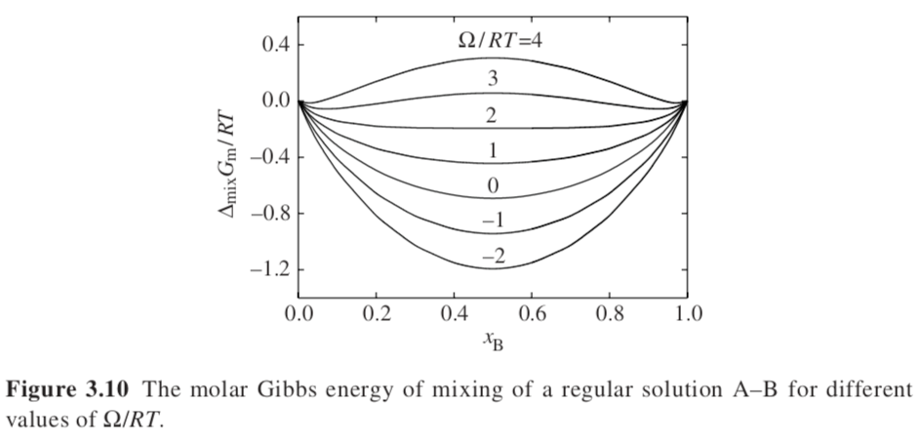
Hildebrand Regular Solution Model
The change on mixing:
ΔS = -nk_{B} (x_{A} ln(x_{A}) + x_{B} ln(x_{B})) Ideal Solution
Since (ln x) is always negative or 0, ΔS is always positive for ideal solutions
ΔG = ΔH -T ΔS
Since (ln x) is always negative or 0, ΔG is positive or negative depending on ΔH :: can mix or demix
Depending on the sign of ΔH
ΔV = (dΔG/dp)_{T} = 0, there is no loss or gain of volume compared to the summed volume
ΔH = n Ω x_{A}x_{B}
is the interaction coefficient or regular solution constant
Molar Gibbs free energy of mixing
ΔG_{m} = RT(x_{A} ln(x_{A}) + x_{B} ln(x_{B})) + Ω x_{A}x_{B}
Ω = zN_{A}[u_{AB} – (u_{AA}+u_{BB})/2]
The equation is symmetric

Slide 23


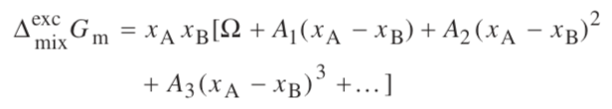
Asymmetric equations for asymmetric phase diagram
Sub-regular solution model
Redlich-Kister Expression

Slide 24




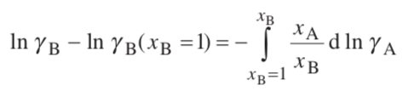
Use of the Gibbs-Duhem Equation to determine the activity of a component
Constant p, T
Restatement of Gibbs-Duhem for Solutions
If you know γ_{A} you can obtain γ_{B} by integration

Slide 25
Course Summary
IV. Phase Diagrams:
Eutectic;
Solid Solution;
L/V vs S/L Ideal; Azeotrope/Congruent; Heteroazeotrope/Eutectic;
Regular solution model;
Lower critical solution behavior (LCST);
Freezing point depression;
Ternary phase diagram;

Slide 26

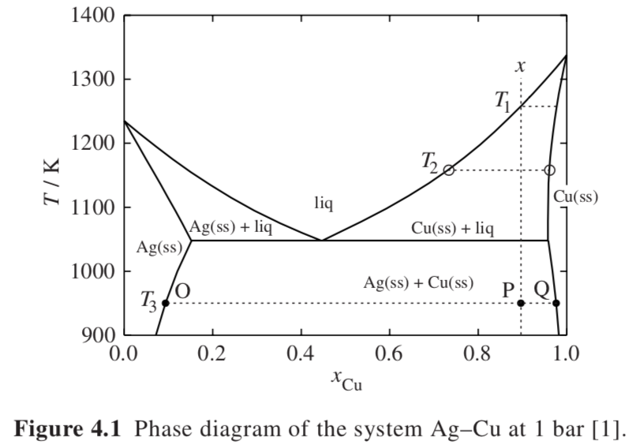




Gibbs Phase Rule
Phase Diagrams
Silver acts like a solvent to copper and copper acts like a solvent to silver with limited solubility that is a function of temperature with a solubility limit at the eutectic point (3 phases in equilibrium)
Eutectic Phase Diagram Ag + Cu
Univariant Equilibrium
Liquidus
Solidus
Invariant Equilibrium
Eutectic
Lever Rule
Tieline (conode)
and
L => α + Β

Slide 27
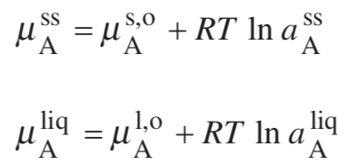
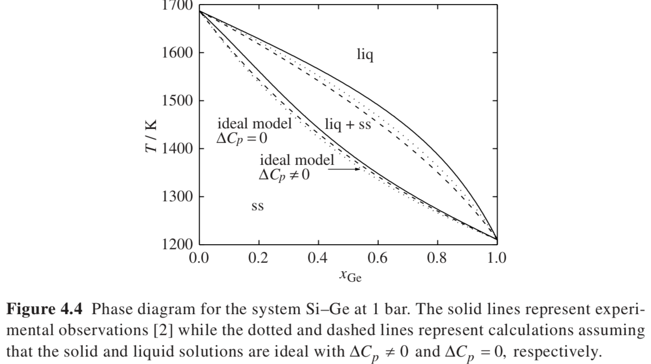
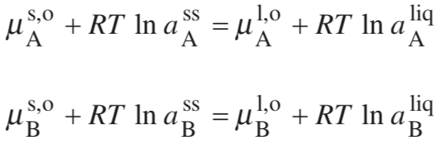


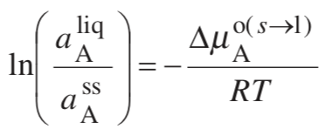
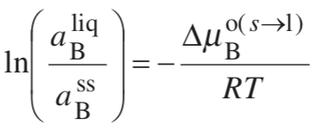



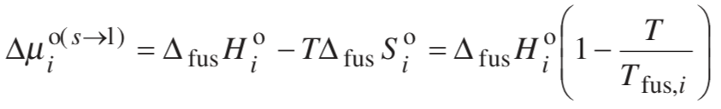
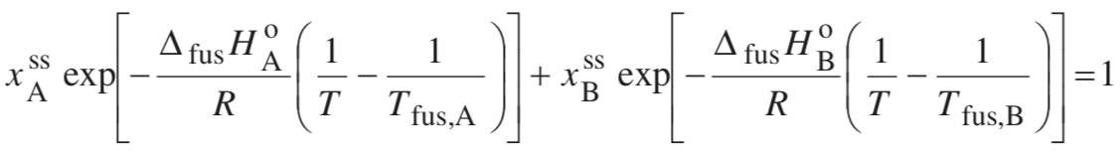
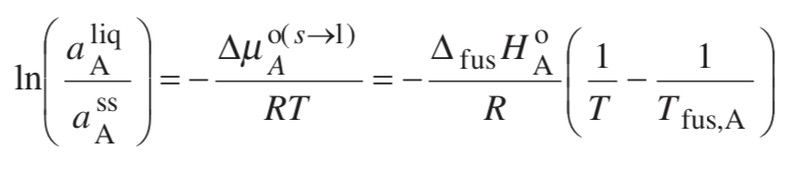
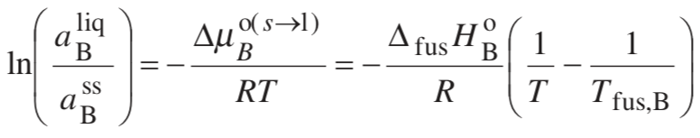
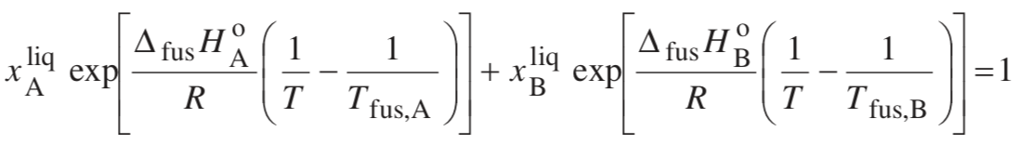
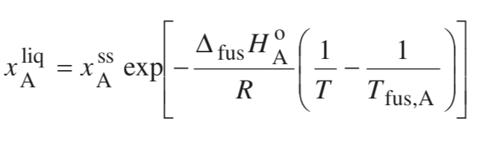
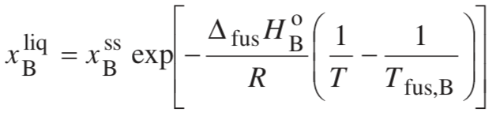
Calculate the Phase Diagram for a Solid Solution
Solve for x_{B}^{SS} x_{B}^{liq} since x_{A} + x_{B} =1
C_{p}(T) is constant
Ideal

Slide 28
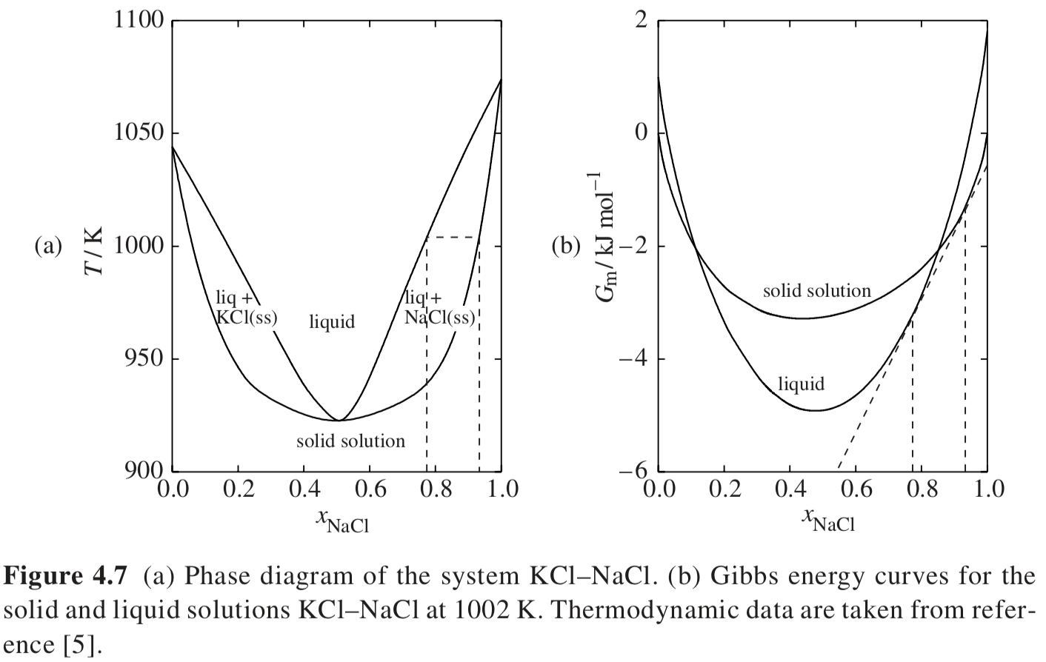
Solid solution is flatter than ideal (Pos. deviation or destabilized) Liquid is deeper than ideal (Neg. Deviation or stabilized)
Deviations are associated with minima in phase diagram

Slide 29
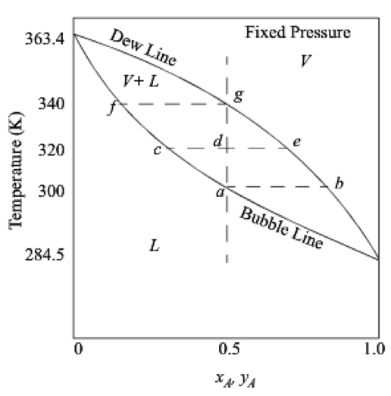
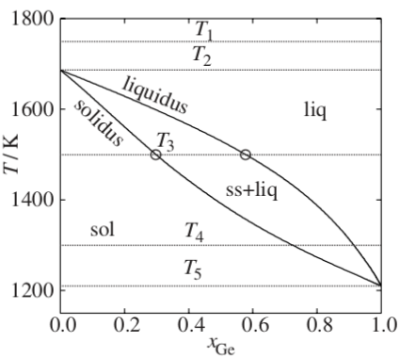
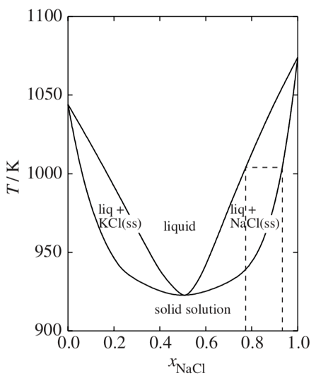
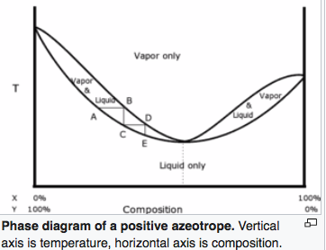
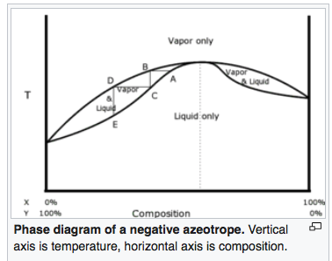
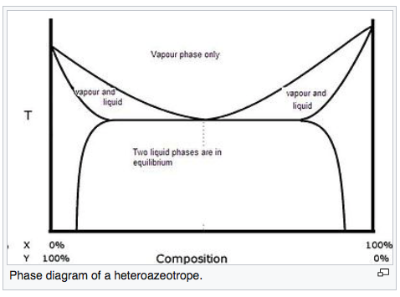
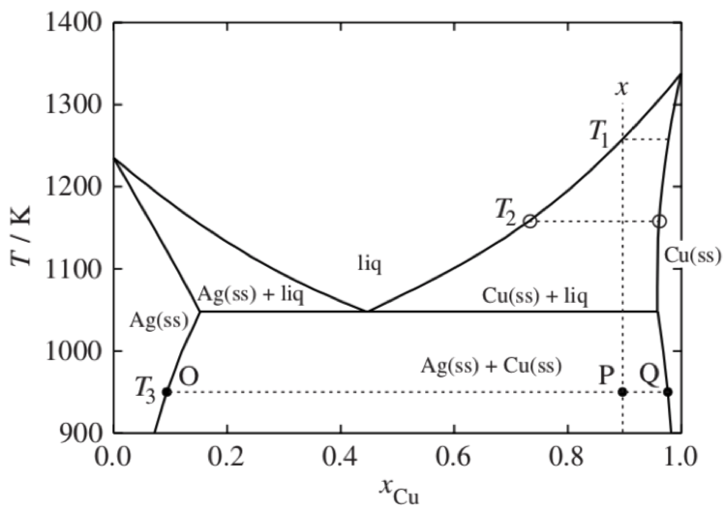
Liquid/Vapor Equilibria
Solid/Liquid Equilibria
Ideal
Ideal
L => α + L
Azeotrope
Phase diagram is split into two phase diagrams with a special composition that acts as a pure component
Non-Ideal
Congruent melting solid solution
L => α
Same crystallographic structure in solid solution phase
Heteroazeotrope
Eutectic
L => α + β
Different crystallographic structures in solid solution phases

Slide 30
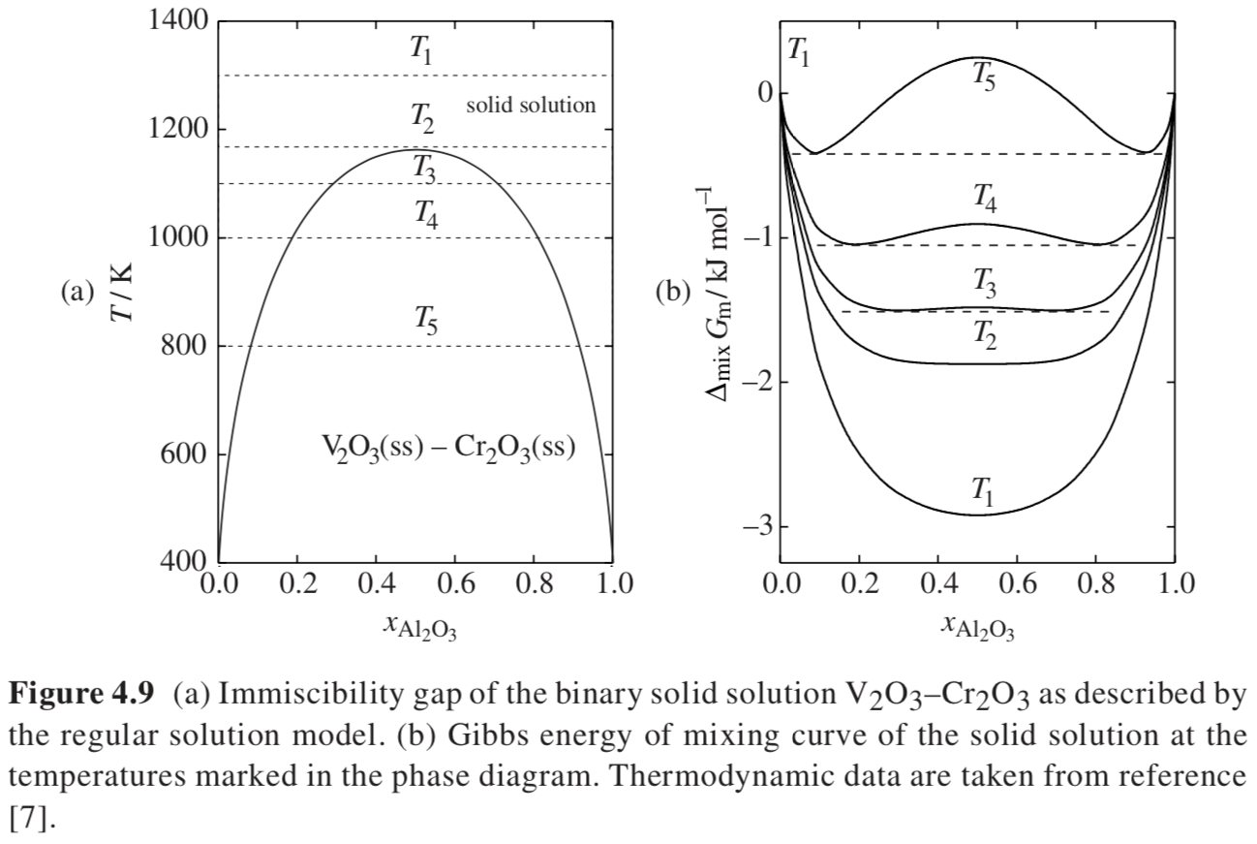
One Crystallographic
Phase
γ => α + β
Two Different Crystallographic
Phases at Equilibrium

Slide 31
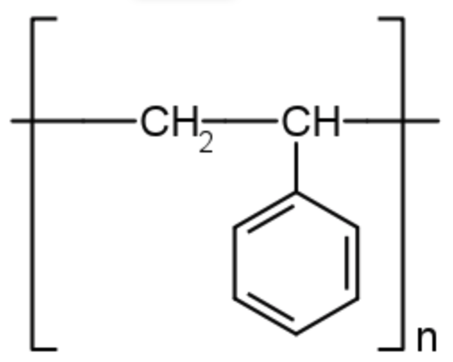
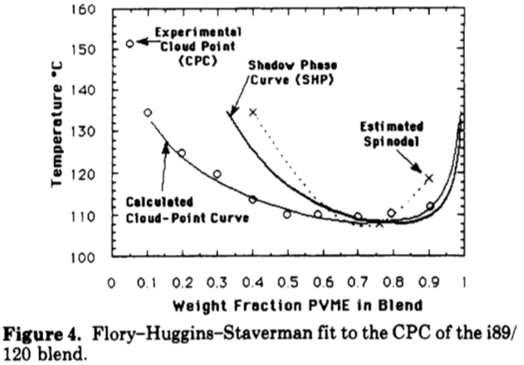
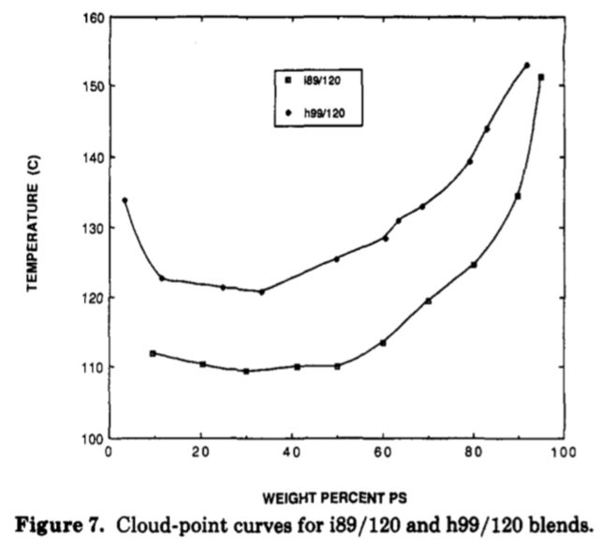
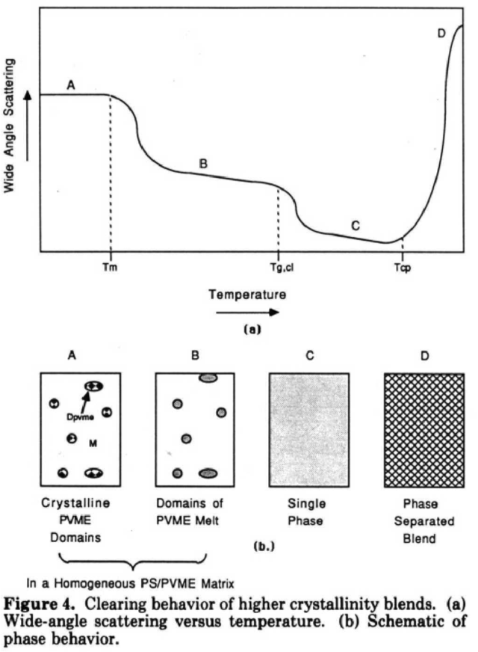


Polyvinylmethyl Ether/Polystyrene (LCST Phase behavior)
2-Phase
2-Phase
Single Phase
Single Phase
ΔG_{m} = RT(x_{A} ln(x_{A}) + x_{B} ln(x_{B})) + Ω x_{A}x_{B}
must have a temperature dependence for UCST
Ω = A + B/T so that it gets smaller with increasing temperature this is a non-combinatorial entropy i.e. ordering on mixing

Slide 32
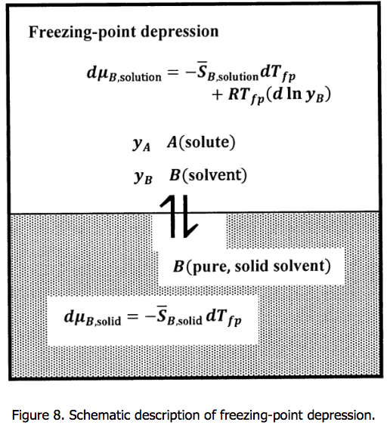
Freezing Point Depression
Pure solid in equilibrium with a binary solution following Henry’s Law
dµ_{B,Solid} = V^{m}_{B,Solid} dP – S^{m}_{B,Solid} dT + RT d(lna_{B,Solid})
Isobaric, pure component B so lna_{B,Solid} = 0
dµ_{B,Solid} = – S^{m}_{B,Solid} dT_{fp}
Binary solution following Henry’s Law
dµ_{B,Solution} = – S^{m}_{B,Solultion} dT_{fp} + RT_{fp} d(lny_{B,Solution})_{P,T}
For small x: e^{-x} = 1 - x + … or ln(1-x) = -x
So, for small y_{B,Solution}: lny_{B,Solution} ~ -y_{A,Solution}
So,
S^{m}_{B,Solid} dT_{fp} = S^{m}_{B,Solution} dT_{fp} + RT_{fp} dy_{A,Solution}
dy_{A,Solution} = (S^{m}_{B,Solid} - S^{m}_{B,Solution})/(RT_{fp}) dT_{fp} ~ -ΔS^{m}_{B}/(RT_{fp}) dT_{fp} = -ΔH^{m}_{B}/(RT_{F}) (dT_{fp})/T_{fp}
y_{A,Solution} = -ΔH^{m}_{B}/(RT_{F}) ln(T_{fp}/T_{F}) For small x: ln(x) = x – 1
y_{A,Solution} = -ΔH^{m}_{B}/(RT_{F}) (T_{fp}/T_{F} - 1) = -ΔH^{m}_{B}/(RT²_{F}) ΔT
T_{fp} = T_{F} - y_{A,Solution}RT²_{F}/ΔH^{m}_{B}

Slide 33
Course Summary
V. Phase Stability:
Metastable;
Supercool; superheat; supersaturate;
Kauzmann Paradox;
Thermal/density fluctuations;
Spinodal decomposition;
Binodal; spinodal; critical conditions;
Polymorphs; allotrophs;

Slide 34
The book considers first a reversible chemical reaction A <=> B
Cyclohexane from boat to chair conformation for instance
Transition
State
Transition
State
Boat
The equilibrium point depends on temperature, k_{B}T
Chair
Metastable
Chair
As temperature changes you can observer a different mix of states, E = k_{B}T ~ 2.5 kJ/mole at RT
But fluctuations allow for 0.1 % boat conformation. At 1073K 30% boat. Probability is exp(-E/kT).
The percent in boat can be measured using NMR spectroscopy.

Slide 35
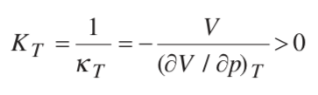
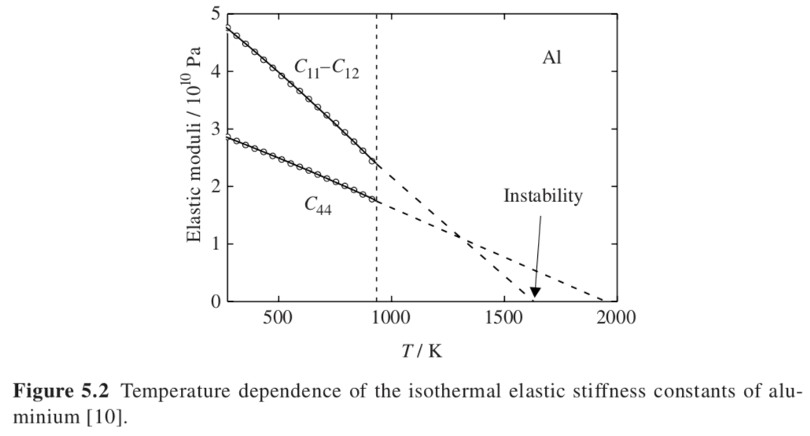
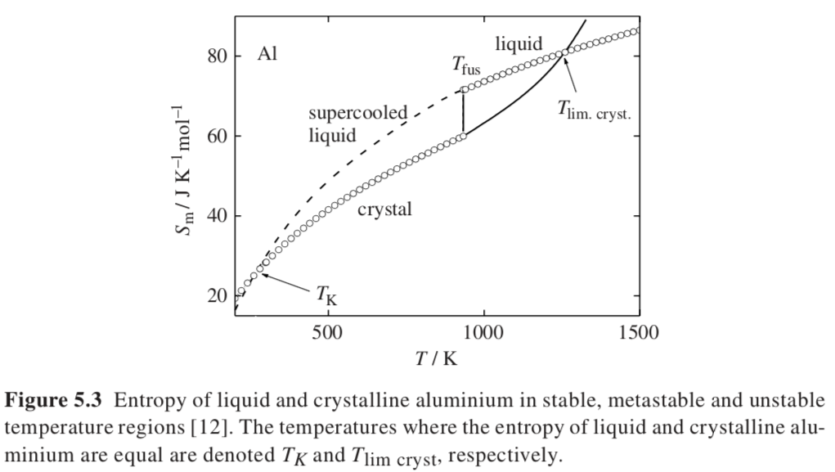
Superheating and Melting
-S U V
H A
-p G T
Superheating can occur since melting occurs at surfaces and if the surfaces are stabilized then superheated solids can be produced
Growth of a liquid phase relies on growth of a mechanical instability
A mechanical instability will not spontaneously grow if it occurs in a meta-stable region in T and P:
(dG/dx)=0 defines equilibrium or binodal; (d²G/dx²) = 0 defines the metastable limit or spinodal
(d³G/dx³) = 0 defines the critical point
G = -ST + Vp, dG = -SdT + Vdp
(d²G/dp²)_{T} = (dV/dp)_{T} < 0 and (d²G/dT²)_{p} = -(dS/dT)_{p} < 0
First requires that the bulk modulus be positive,
Second requires positive heat capacity, (dS/dT)_{p} = C_{p}/T > 0
Shear modulus goes to 0 at highest possible supercritical solid

Slide 36
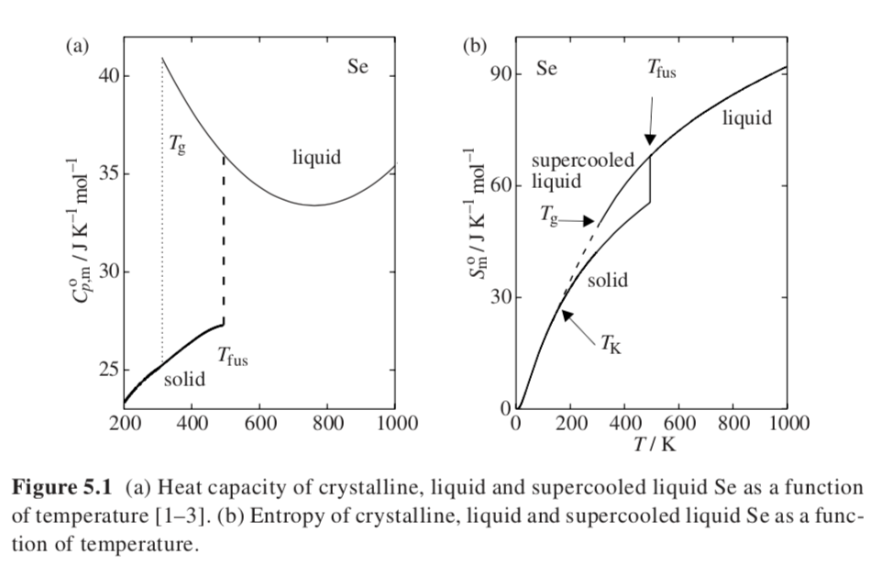
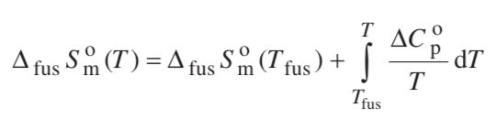
Kauzmann Paradox,
a thermodynamic basis for the glass transition
The entropy of the liquid becomes smaller than the entropy of the solid at the Kauzmann temperature, T_{K}. This could be the infinite cooling glass transition temperature.

Slide 37
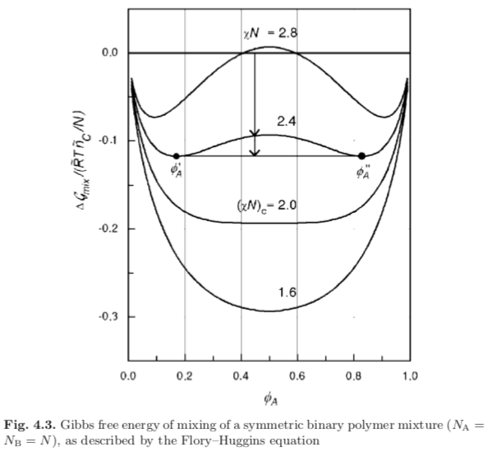
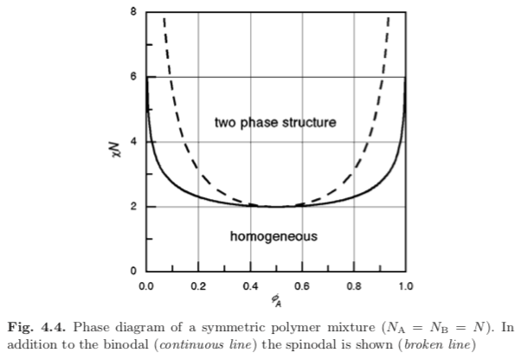
Since χN depends on 1/T specifying χN specifies the temperature. Large χN is low tempearature.

Slide 38
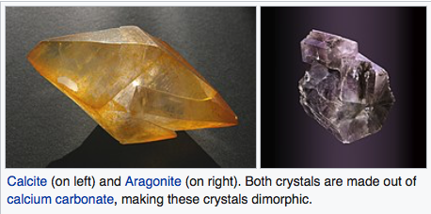
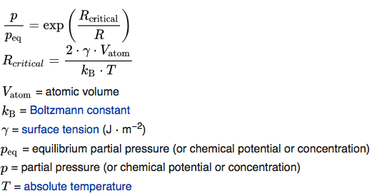
Polymorphs and Allotrophs
Allotroph: Carbon as diamond or graphite
Polymorph: Titania as anatase or rutile
Silica as α-quartz, β-quartz, tridymite, cristobalite, moganite, coesite, and stishovite
Calcium carbonate as calcite or argonite
Ostwald’s rule: Most stable polymorph does not always crystallize, rather, meta-stable polymorphs form at a higher rate if the surface tension difference between the melt/liquid solution and the polylmorph is small.
Ostwald ripening: Metastable polymorphs may form small crystals. Over time stable polymorphs grow from these small crystals into large crystals. This has been generalized to growth of large phases due to ripening such as in crushed ice or ice cream.
Ostwald Freundlich Equation: Small crystals dissolve more easily than large crystals. This is the reason for Ostwald ripening. Also true for vapor pressure of a liquid droplet (replace x with p)
Ostwald step rule: Least stable polymorph crystallizes first since it has
a free energy that is closest to the liquid or solution state. This means that metastable phases form kinetically first if they exist. If many polymorphs exist, they will form in order of free energy with the highest forming first.

Slide 39
Course Summary
VI. Surfaces:
Surface excess properties;
Surface area and curvature;
Laplace equation (pressure versus curvature/size);
Contact angle;
Kelvin equation (vapor pressure for a droplet/bubble);
Solubility versus size;
Critical nucleus size;
Ostwald ripening;
Heterogeneous versus homogeneous nucleation;
Gibbs-Thompson and Ostwald-Freundlich equations;
Chemical (irreversible) or physical adsorption (reversible);
Adsorption isotherm (Langmuir, BET);
Block copolymers;

Slide 40


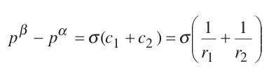
-S U V
H A
-p G T
c is curvature 1/r
Laplace Equation
For a 100 nm (1e⁻⁵ cm) droplet of water in air (72 e⁻⁷ J/cm² or 7.2 Pa-cm)
Pressure is 720 MPa (7,200 Atmospheres)

Slide 41



Dihedral angles

Slide 42


Young Dupre Equation

Slide 43










-S U V
H A
-p G T
Pressure for equilibrium of a liquid droplet of size ”r”
Reversible equilibrium
At constant temperature
Differential Laplace equation
Small drops evaporate, large drops grow

Slide 44





Solubility and Size, r
Consider a particle of size r_{i} in a solution of concentration x_{i} with activity a_{i}
Derivative form of the Laplace equation
Dynamic equilibrium
For an incompressible solid phase
Definition of activity
Solubility increases exponentially with reduction in size, r
(x_{i}^{l})_{r} = (x_{i}^{l})_{r=∞} exp(2γ^{sl}/(ρRT r))
Small particles dissolve to build large particles with lower solubility
-To obtain nanoparticles you need to supersaturate to a high concentration (far from equilibrium).
-Low surface energy favors nanoparticles. (Such as at high temperatures)
-High temperature and high solid density favor nanoparticles.
Supersaturation is required for any nucleation

Slide 45





Critical Nucleus and Activation Energy for Crystalline Nucleation (Gibbs)
Bulk decreases free energy
Surface increases free energy
(M/r)is molar volume
Barrier energy for nucleation at the critical nucleus size beyond which growth is spontaneous

Slide 46

Critical Nucleus and Activation Energy for Crystalline Nucleation (Gibbs)
Δ_{fus}G_{m} = Δ_{fus}H_{m} - TΔ_{fus}S_{m}
Lower T leads to larger Δ_{fus}G_{m} (Driving force for crystallization)
smaller r* and smaller Δ_{l-s}G*
Deep quench, far from equilibrium leads to nanoparticles

Slide 47


Ostwald Ripening
Dissolution/precipitation mechanism for grain growth
Consider small and large grains in contact with a solution
Grain Growth and Elimination of Pores

Slide 48












Formation of a surface nucleus versus a bulk nucleus from n monomers
Homogeneous
Heterogeneous (Surface Patch)
Bulk vs n-mer
So surface excess chemical potential
Surface energy from the sides of the patch

Slide 49


Barrier is half the height for nucleation
Size is half

Slide 50






Three forms of the Gibbs-Thompson Equation
Ostwald-Freundlich Equation
x = supersaturated mole fraction
x∞ = equilibrium mole fraction
ν₁ = the molar volume
Free energy of formation for an n-mer nanoparticle from a supersaturated solution at T
Difference in chemical potential between a monomer in supersaturated conditions and equilibrium with the particle of size r
At equilibrium
For a sphere

Slide 51

Three forms of the Gibbs-Thompson Equation
Ostwald-Freundlich Equation
Areas of sharp curvature nucleate and grow to fill in. Curvature κ = 1/r
Second Form of GT Equation

Slide 52




Three forms of the Gibbs-Thompson Equation
Third form of GT Equation/ Hoffman-Lauritzen Equation
B is a geometric factor from 2 to 6
Crystallize from a melt, so supersaturate by a deep quench
Free energy of a crystal formed at supercooled temperature T

Slide 53




Adsorption Isotherms
B_{g}-Gas species (N₂)
B_{mon} – Adsorbed (N₂) in an occupied surface site
V_{mon} – Available surface site
Equilibrium Constant:
a_{B}^{g} is activity of B in the gas phase
Langmuir Adsorption Isotherm
θ = Γ_{B}/Γ_{B}^{Max} Fractional Coverage
Γ_{B}^{Max} Is the coverage for a monolayer.

Slide 54
Derivation of Langmuir Equation (as derived by Hill)
Langmuir Equation is for equilibrium of a monolayer with a solution of concentration x₂
A surface has adsorption sites that can hole solvent (1) or solute (2)
Some fraction of the surface bound to solute, x₂^{b}, and some fraction to solvent, x₁^{b}.
The concentration of solute in the solution ((partial pressure or pressure)/saturated pressure) is x₂^{s} = θ
The equilibrium involves x₁^{b} + x₂^{s} ⬄ x₁^{s} + x₂^{b}
The equilibrium constant is given by, K = (x₁^{b} x₂^{s})/(x₁^{s} x₂^{b}) = (1 - x₂^{b}) θ /((1 - θ) x₂^{b})
Rearranging yields θ = Kx₂^{b}/(1 - x₂^{b} + K x₂^{b}) ~ Kx₂^{b}/(1 + K x₂^{b}) = p/p₀

Slide 55


Derivation of BET Theory
Langmuir Equation is for monolayers
BET is for multilayers where the first layer has an energy of adsorption, E₁, and second and higher layers use the energy of liquification, E_{L}
Langmuir Equation is applied for each layer (gas and adsorbed layer are at dynamic equilibrium)
At P^{sat} the surface is in the liquid (For Langmuir this was a monolayer)
Fractional coverage of layer i, θ_{i}
Rate of adsorption on layer i-1 to fill layer i, R_{i-1,ads} = k_{i,ad} P θ_{i-1}
Rate if desorption from layer I, R_{i,des} = k_{i,des} θ_{i}
k_{i,ads} = k_{i,des} = exp(-E_{i}/kT)
ν_{m} = monolayer amount of gas
ν = experimental amount of gas adsorbed

Slide 56


How can you predict the phase size? (Meier and Helfand Theory)
Consider lamellar micro-phase separation.
d_{A}
d_{t}
d_{B}
Perfect match

Slide 57
Course Summary
VII. Heat of Formation:
Dependencies in periodic table;
Electronegativity;
Energetics of formation (electrostatic, repulsion, dispersion, polarization, crystal field);
Atomic size (perovskites, spinels, zeolites);
Substitutional solids;
Conformational entropy of polymers

Slide 58

Electronegativity, the ability of an atom to attract electrons in a bond
Linus Pauling

Slide 59

d-orbitals
10 valence electrons
Transition
Metals
Acidic (at high oxidation state)
Acidic
Basic
Basic (at low oxidation state)
s-orbitals
2 valence electrons
(more basic to right)
p-orbitals
6 valence electrons
(more acidic to right)
f-orbitals
14 valence electrons

Slide 60


Energetics of compound formation
Electrostatic attraction +-
Electron electron repulsion
Van der Waals or dispersion (δ+ makes δ- leads to net attraction)
Polarization (shifting within compound of electrons)
Crystal field effects

Slide 61


Conformational Enthalpy of Polymers
The Rotational Isomeric State Model of Volkenstein and Paul Flory (Nobel Prize)
Carbon has a tetrahedral bonding arrangement
For a chain of carbon the two side groups interact with the side groups of neighboring carbons
For Butene
“Trans” is sterically the most favorable arrangement
“Gauche +” and “Gauche -” are less favorable
The Boltzmann equation gives the probability of a particular conformation, Z is the partition function or the sum of all of the different Boltzmann expressions in an ensemble

Slide 62



Conformational Enthalpy of Polymers
The Rotational Isomeric State Model of Volkenstein and Paul Flory (Nobel Prize)
For a polymer with N carbons there are N-2 covalent bonds
The number of discrete conformation states per chain is ν^{N-2} where ν is the number of discrete rotational states for the chain, tttt, g⁻g⁻g⁻g⁻,g⁺g⁺g⁺g⁺,g⁺ttt, etc. for N = 4; N₁=1, N₄=4, etc. assuming no end effects
Average rotational angle
Q is the bond angle
180°-109° = 71°
E_{g+-} = 2100 J/mole
C∞ = 3.6
Exp. 6.7
Characteristic Ratio

Slide 63
Course Summary
VIII. Heat Capacity:
Cp-Cv;
Internal energy of a gas;
Dulong-Petit Law for solids;
Phonons; longitudinal; transverse; optical; acoustic
Brillouin Zones;
Acoustic phonons; Optical Phonons
Density of states;
Bose-Einstein statistics;
Einstein model;
Debye model;
Dispersion relations;
Debye temperature; Debye frequency;
Modulus and heat capacity;
Grüneisen parameter Cp-Cv
Spectroscopy; density of states; heat capacity;
Entropy from heat capacity;
Heat capacity from group contribution;
Electronic heat capacity;
Heat capacity at second order transitions;
Heat capacity of polymers

Slide 64
Heat Capacity
DSC
Heat is not a state function, so we define a state function related to heat, dS = dQ/T
-S U(E) V
H A(F)
-p G T
dH = VdP + TdS
At constant P (dH = TdS = dQ)_{P}
We have C_{p} = (dH/dT) _{P} = (dQ/dT) _{P}
In the DSC we measure the heat flow dQ/dt (Watts) at a constant heating rate dT/dt at constant pressure,
(dQ/dT) _{P} = C_{p}
So, the y-axis is C_{p} times dT/dt the latter of which is constant

Slide 65

C_{p} = (dH/dT) _{P} = (dQ/dT) _{P} = ((dQ/dt) / (dT/dt))_{P}

Slide 66
Derive the expression for C_{p} – C_{V}
From Chapter 1
-S U V
H A
-p G T
C_{p} - C_{v} = α²VT/κ_{T}
α = (1/V) (dV/dT)_{p}
κ_{T} = (1/V) (dV/dP)_{T}
C_{V} = (dU/dT)_{V}
From the Thermodynamic Square
dU = TdS – pdV so C_{V} = (dU/dT)_{V} = T (dS/dT)_{V} - p (dV/dT)_{V}
Second term is 0 dV at constant V is 0
(dS/dT)_{V} = C_{V} /T
Similarly
C_{p} = (dH/dT)_{p}
From the Thermodynamic Square
dH = TdS + Vdp so C_{p} = (dH/dT)_{p} = T (dS/dT)_{p} - V (dp/dT)_{p}
Second term is 0 dp at constant p is 0
(dS/dT)_{p} = C_{p} /T
Write a differential expression for dS as a function of T and V
dS = (dS/dT)_{V}dT + (dS/dV)_{T}dV using expression for C_{V} above and Maxwell for (dS/dV)_{T}
dS = C_{V} /T dT + (dp/dT)_{V}dV use chain rule: (dp/dT)_{V} = -(dV/dT)_{p} (dP/dV)_{T} = Vα / (Vκ_{T})
Take the derivative for C_{p}: C_{p}/T = (dS/dT)_{p} = C_{V} /T (dT/dT)_{p} + (α/κ_{T})(dV/dT)_{p} = C_{V} /T + (Vα²/κ_{T})
C_{p} - C_{v} = α²VT/κ_{T}

Slide 67


Slide 68


Monoatomic H(g) with only translational degrees of freedom is already fully excited at low temperatures. The vibrational frequencies (n) of H2(g) and H2O(g) are much higher, in the range of 100 THz, and the associated energy levels are significantly excited only at temperatures above 1000 K. At room temperature only a few molecules will have enough energy to excite the vibrational modes, and the heat capacity is much lower than the classical value. The rotational frequencies are of the order 100 times smaller, so they are fully excited above ~10 K.

Slide 69




Atoms in a crystal (Dulong and Petit Model)
Works at high temperature
Three Harmonic oscillators, x, y, z
Spring (Potential Energy)
dU/dx = F = -kx where x is 0 at the rest position
U = -1/2 kx²
Kinetic Energy
U = ½ mc²
Each atom in a solid has 6 springs
Each spring with ½ kT energy
So, 6/2R = 3R = C_{v}
Three oscillator per atom so U_{m} = 3RT
-SUV
H A
-pGT
dU = -pdV + TdS
d(U/dT) _{V} = T(dS/dT) _{V} = C_{V}

Slide 70

Phonons
Two size scales, a and λ
If λ ≥ a you are within a Brillouin Zone
Wavevector k = 2π/λ
k-vector is like the inverse-space vectors for the lattice
It is seen to repeat in inverse space making an inverse lattice
A phonon with wavenumber k is thus equivalent to an infinite family of phonons with wavenumbers k ± 2π/a, k ± 4π/a, and so forth.
Brillouin zones, (a) in a square lattice, and (b) in a hexagonal lattice
those whose bands become zero at the center of the Brillouin zone are called acoustic phonons, since they correspond to classical sound in the limit of long wavelengths. The others are optical phonons, since they can be excited by electromagnetic radiation.

Slide 71


Phonons
Two size scales, a and λ
If λ ≥ a you are within a Brillouin Zone
Wavevector k = 2π/λ
The density of states is defined by
The partition function can be defined in terms of E or in terms of k
E and k are related by the dispersion relationship which differs for different systems
For a longitudinal Phonon in a string of atoms the dispersion relation is:

Slide 72

Phonons
Bose-Einstein statistics gives the probability of finding a phonon in a given state:

Slide 73

Phonons
Dispersion relation for phonons
Plus optical
Minus Acoustic

Slide 74



Einstein Model
Works at low and high temperature
Lower at low temperature
Quantized energy levels
Bose-Einstein statistics determines the distribution of energies
The mean “n” at T is given by
Average energy for a crystal with three identical oscillators

Slide 75


Einstein Model
Works at low and high temperature
Lower at low temperature
Average energy for a crystal with three identical oscillators
Einstein temperature:

Slide 76



Dispersion Curve
Angular frequency of vibrations as a function of wavevector, q
First Brillouin Zone of the one-dimensional lattice
Longer wavevectors are smaller than the lattice

Slide 77

Longitudinal and Transverse dispersion relationships for [100],[110], and [111] for lead
Transverse degenerate for [100] and [111] (4 and 3 fold rotation axis)
Not for [110] (two fold rotation axis)

Slide 78



Higher Characteristic T represents stronger bonds

Slide 79

Higher Characteristic T represents stronger bonds

Slide 80

Modulus and Heat Capacity
= E ε
F/A = E Δd/d
F = K Δd
K = F/Δd = E A/d
At large q, ω = √(4K/m)
This yields ω_{D} from E
For Cu, θ_{D} = 344K
ω_{D} = 32 THz
K = 13.4 N/m
ω_{D} = 18 THz

Slide 81


Spectroscopy measures vibrations, this can be used to calculate the density of states, this can be integrated to obtain the heat capacity
Number of vibrational modes
IR: High Polarity Motion of charged atoms under electromagnetic field
NaCl
Raman: High Polarizability
Motion of electrons in polarizable bonds under electromagnetic field
Benzene, Graphene, Nanotubes,

Slide 82






Entropy from Heat Capacity
-SUV
H A
-pGT
C_{V} = (dU/dT)_{V}
From the Thermodynamic Square
dU = TdS – pdV so C_{V} = (dU/dT)_{V} = T (dS/dT)_{V} - p (dV/dT)_{V}
Second term is 0 dV at constant V is 0
(dS/dT)_{V} = C_{V} /T
Similarly
C_{p} = (dH/dT)_{p}
From the Thermodynamic Square
dH = TdS + Vdp so C_{p} = (dH/dT)_{p} = T (dS/dT)_{p} - V (dp/dT)_{p}
Second term is 0 dp at constant p is 0
(dS/dT)_{p} = C_{p} /T
Integrate C_{p}/T dT or Integrate C_{V}/T dT to obtain S
Low Temperatures Solve Numerically
High Temperatures Series Expansion

Slide 83




Add an electron from Ag raises Fermi level
Add a hole from Rh reduces n(ε_{F})
A striking example is the electronic heat capacity coefficients observed for Rh–Pd–Ag alloys given in Figure 8.22 [17]. In the rigid band approach the addition of Ag to Pd gives an extra electron per atom of silver and these electrons fill the band to a higher energy level. Correspondingly, alloying with Rh gives an electron hole per Rh atom and the Fermi level is moved to a lower energy. The variation of the electronic heat capacity coefficient with composition of the alloy maps approximately the shape of such an electron band.

Slide 84





From Kittel and Kroemer Thermal Physics Chapter 2
For a system with quantized energy and two states ε₁ and ε₂, the ratio of the probabilities of the two states is given by the Boltzmann potentials, (τ is the temperature k_{B}T)
If state ε₂ is the ground state, ε₂ = 0, and the sum of exponentials is called the partition function Z, and the sum of probabilities equals 1 then,
Z = exp(-ε₂/τ) + 1
Z normalizes the probability for a state “s”
P(ε_{s}) = exp(-ε_{s}/τ)/Z
The average energy for the system is $U={\left(\sum{ε_{i}e^{−ε_{i}/τ}}\right)}/Z=τ^{2}\left(\frac{dlnZ}{dτ}\right)$

Slide 85



Heat Capacity of Polymers
Amorphous structure but with regular order along the chain
1-d vibrational structure
Einstein method works well above 100K
N_{atoms} = number of atoms in a mer unit
3 for CH₂
N = number of skeletal modes of vibration
N = 2 for -(CH₂)_{n}-

Slide 86
Course Summary
IX. Solution Models and Equations of State:
Regular solution;
Quasi-regular solution with lattice vibrations;
Accounting for correlations (mean field or specific interactions);
Virial approach for mean field;
Correlation function for specific interactions;
Van der Waals model;
Margulis model; Margulis acid-base;
Redlich-Kister model (asymmetric phase diagrams);
Scatchard-Hildebrand theory (volume versus mole fraction);
Flory-Huggins model (polymers based on volume fraction);
Group Contribution Models:
Hydrogen bonding MOSCED (Modified separation of cohesive energy density); SSCED (Simplified separation of cohesive energy density);
Local Clustering Models: Wilson’s equation; NRTL (Non-random two liquid model);
Surface area rather than volume fraction for interactions: UNIQUAC (Universal quasi-chemical model);
UNIFAC (Universal functional activity coefficient model);
Solutions with multiple sublattices (NaCl);
Order-disorder systems
Order parameter
Non-stoichiometric compounds (perovskite oxides)

Slide 87






Regular Solution Solution Model
µ_{A} ~ dG/dx_{A}

Slide 88


Excess molar Gibbs energy of mixing for quasi-regular solution
G = H –TS so first term is enthalpic, second is entropic
τ is a characteristic temperature, when T = τ ideal solution behavior is seen

Slide 89

Correlations
Dilute: Ideal behavior, there are no interactions
Semi-dilute: weak or strong interactions are possible
With weak interactions the system can be treated with a “mean field”. No correlation is observed, we can use the second virial coefficient and Hildebrand Model
With strong interactions we need to use detailed information about interactions, correlation function or other models

Slide 90



Slide 91





Chapter 11 Elliot and Lira
Margulis one-parameter Model
Hildebrand Model
Margulis acid-base Model

Slide 92
Course Summary
X. Thermodynamics and Materials Modeling:
Quantum mechanics (ab initio method, electronic wave functions, nuclei don’t move);
Density functional theory (Minimize E(ρ) as a function of ρ(r));
Molecular dynamics modeling (potential fields between atoms);
Mesoscale models (coarse graining; short range interaction potentials);
Dissipative particle dynamics (DPD);
Monte Carlo Metropolis method;
Ising model;
Packages to do materials simulations of different types: LAMMPS; HOOMD-blue; ESPResSo; etc.
Free servers for simulations from Google: Colaboratory

Slide 93

Thermodynamics and Materials Modeling
Coarse Grain Simulations
DPD Simulations
Machine Learning
Data Mining Techniques

Slide 94


Quantum mechanical/ab initio methods
Electronic wavefunction is independent of the nuclei since electrons are much smaller and move much faster: Born Oppenheimer Approximation
Solve the Schrodinger equation
Hamiltonian in atomic units:
r_{i} electron positions; d_{α} nuclear positions, Z_{α} nuclear charge
Kinetic Energy – e⁻ nuc. attraction + e⁻ e⁻ repulsion + Nuc. Nuc. repulsion
Solve approximately since true wave function can’t be found directly. Compare proposed function results with data. Variational Principle: lowest energy wins.
4) Obey Pauli exclusion principle.

Slide 95


Density functional theory
Ground state can be obtained through minimization of E(ρ) of ρ(r)
Parallel non-interacting system (NIS)
3) Write the energy functional as
KE of NIS + e⁻ nuc. int. + Coulomb + exchange correlation energy
Minimize E[ρ] to obtain wave functions then iterate to obtain the ground
state density and energy

Slide 96


Molecular Dynamics
Generate initial condition with particles identified by position and velocity
Calculate the force on each particle using potentials
Forces (accelerations) remain constant for a time step, position and velocity change
Repeat 3) until temperature is constant
After steady state record velocities and positions so that <r²> = 6Dt is found
Time calculation is on the order of nanoseconds.
Neither Monte Carlo nor Molecular Dynamics can calculate the free energy since they ignore large energy regions of phase space
They can calculate differences in free energy for phase diagram construction

Slide 97

Coarse Grain Simulations
DPD Simulations
Machine Learning
Data Mining Techniques

Slide 98

Coarse Grain Simulations
DPD Simulations
Machine Learning
Data Mining Techniques

Slide 99



Monte Carlo/Metropolis Method
Periodic Boundary Conditions
Fix T, V, N
“Z” is a state of the system
Calculate φ(Z) by molecular mechanics with potentials
Accept a configuration “Z” if it has a low energy relative to kT with some randomness
Calculate the average
Start with a random configuration calculate φ(Z)
Move one atom or molecule or group of molecules
Calculate φ(Z’) if lower than φ(Z) accept
If higher than φ(Z) calculate exp(-Δφ/kT) and a random number from 0 to 1
If higher than random number accept
Repeat

Slide 100

Dissipative Particle Dynamics (DPD)

Slide 101
Course Summary
XI. Experimental Thermodynamics
Calorimetry
Differential Scanning Calorimetry
Modulated DSC
Microcalorimetry
Differential Thermal Analysis
Thermal Gravimetric Analysis
Bomb Calorimetry/Combustion Calorimetry
And 25 other techniques

Slide 102
Course Summary
I. Introduction
II. Single component systems
III. Solutions
IV. Phase diagrams
V. Phase stability
VI. Surfaces
VII. Heat of formation
VIII. Heat capacity
IX. Solution models and equations of state
X. Thermodynamics and materials modeling
XI. Experimental methods

